Slide 1

Swarm: Mining Relaxed Temporal Moving Object Clusters
Zhenhui (Jessie) Li, Bolin Ding, Jiawei Han University of Illinois at Urbana-Champaign
Roland Kays
New York State Museum
VLDB conference
Singapore
September 15, 2010
Work supported by NSF, ARL (NS-CTA), AFOSR (MURI), NASA, and Boeing

Slide 2
Outline
Motivation
Problem Definition
Algorithm
Experiment
Summary
Discussion

Slide 3
Outline
Motivation
Problem Definition
Algorithm
Experiment
Summary
Discussion

Slide 4
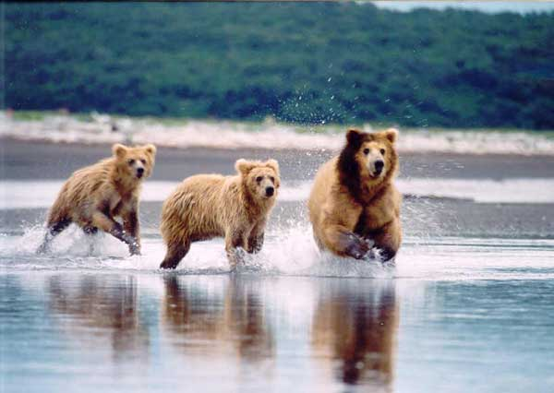
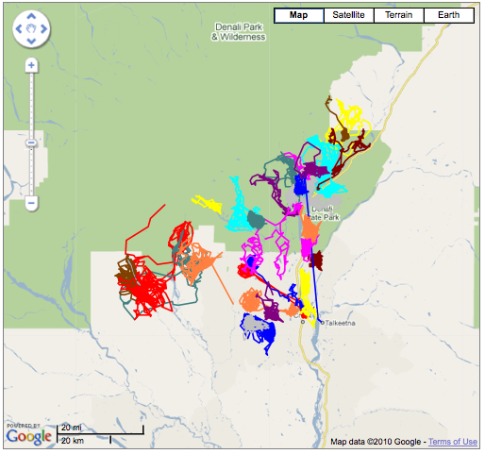
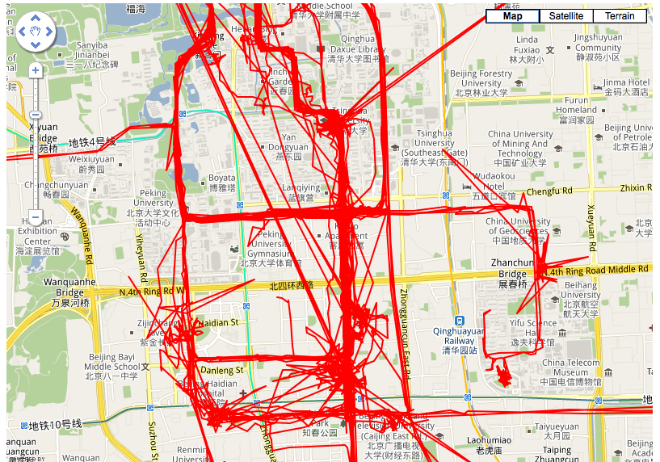
Widely Available Moving Object Data
Animal movement data
  Biological studies
  Data collected by tags, sensors, GPS
  MoveBank.org: 173 animal datasets (bear, buffalo, deer, fish, coyote...)
Human movement data
  Location-based service
  Data collected by vehicle GPS, cell phones
  GeoLife project at MSRA: ~200 human trajectories

Slide 5
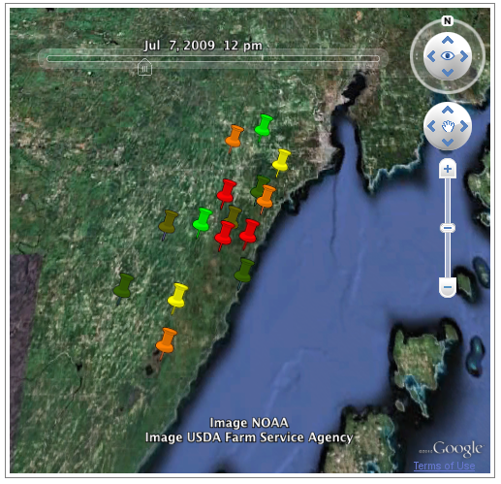
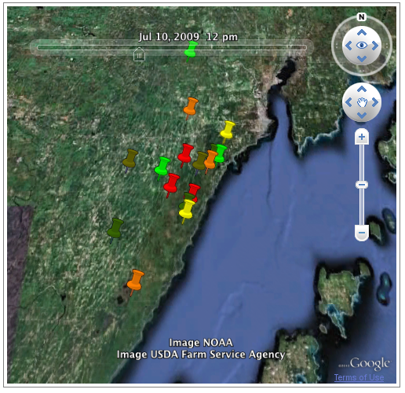
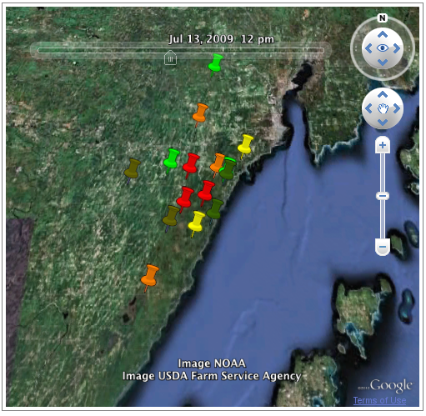
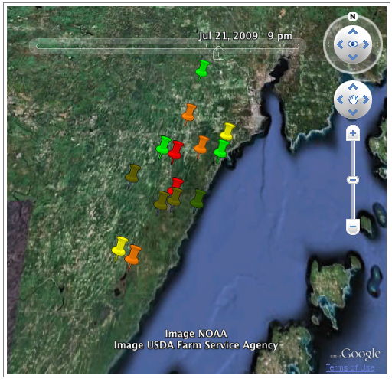
Mining the Relationships of Moving Objects
The most basic relationship of moving objects: being together
  Animals in the same herd
  Human could have relationships: husband/wife, colleagues, friends
10:00
11:00
12:00
13:00
Time
One snapshot only tells temporary locations at one time
Relationship can only be detected dynamically over time

Slide 6
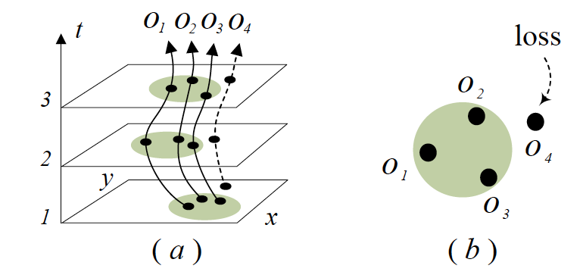
“Moving Cluster”: Moving together for “Consecutive Times”??
Flock
[Gudmundsson, GIS’06]
Objects are within a circle for k consecutive times
Convoy
[Jeung, VLDB’08]
Objects are within a cluster for k consecutive times
From [Jeung, VLDB’08]
Flock fails to detect cluster with any shape
Convoy fails to detect moving clusters for non-consecutive times

Slide 7
Relaxing Temporal Constraint: Essential for Detection of Moving Relationships
Reason 1. In real application, objects could meet and depart
Example:
People travel: group/individual activity
Animal migrate: move/hunt for food
Reason II. It makes the moving object cluster detection less sensitive to “closeness” parameter
5.1m
not close?
3.5m
3m
4m
Example:
- “5 meters” = “close enough”?

Slide 8
Outline
Motivation
Problem Definition
Algorithm
Experiment
Summary
Discussion

Slide 9
Swarm: A New Defn. of Moving Object Cluster
Given clusters of moving objects for each time snapshot,
Example:
min_{o} = 2, min_{t} = 3
O = {o₁,o₂,o₄}
T = {t₁, t₂, t₄}
(O,T) forms a swarm
A set of objects O, a set of timestamps T, (O, T) forms a swarm:
|O| ≥ min_{o}
|T| ≥ min_{t}
For each timestamp t in T, objects in O are in the same cluster.

Slide 10
Closed Swarm: Reducing Redundancy
Swarm (O,T):
  time-closed swarm
    No swarm (O,T’), where T’>T
    ((o1,o2),(t1,t2)) is NOT time-closed
    ((o1,o2),(t1,t2,t4)) is time-closed
  object-closed swarm
    No swarm (O’,T), where O’>O
    ((o1,o2),(t1,t2,t4)) is NOT object-closed
    ((o1,o2,o4),(t1,t2,t4)) is object-closed
Closed swarm is both time-closed and object-closed
min_{o} = 2
min_{t} = 3

Slide 11
Outline
Motivation
Problem Definition
Algorithm
Experiment
Summary
Discussion

Slide 12
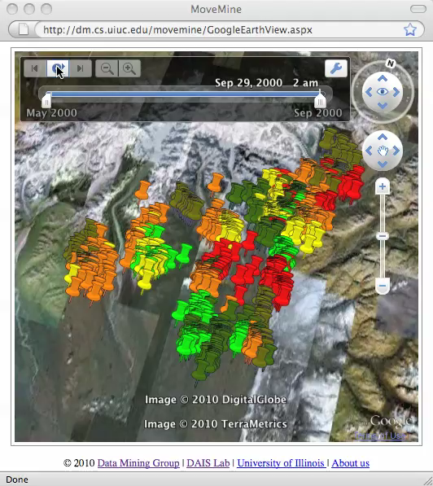
Swarm Mining: A Challenging Problem
It is very hard to detect swarm manually
The possible combination of swarm is huge:
  e.g.: the possible combination for swarms is 2³²*2⁹⁰
32 bears in Alaska, 2000. May — 2000. Sept
Trajectories plotted
Movement animated

Slide 13
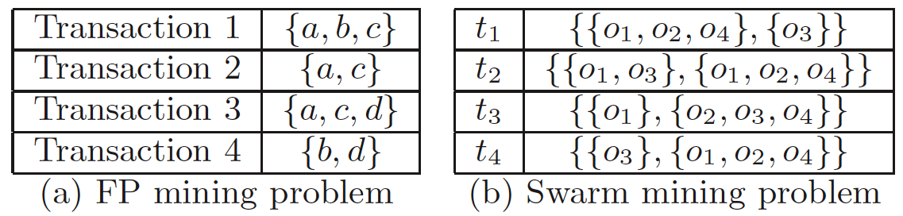
Why Not Traditional Frequent Pattern Mining?
FP mining problem: a set of objects for each transaction
Swarm mining problem: a set of clusters (cluster = a set of objects) for each timestamp

Slide 14
ObjectGrowth:
Depth-First Search Based on Objects
Naïve approach
  enumerate every combination of (O,T)
  search space: 2^{number of objects}*2^{number of times}
We only need to enumerate objectset
  Reduce the search space from 2^{number of objects}*2^{number of times} to 2^{number of objects}
Example:
If O={o₁,o₂}, only when T={t₁,t₂,t₄}, (O,T) is possibly time-closed. Such T is called the maximal timeset of O.
T_{max}(O) = {t₁,t₂,t₄}.

Slide 15
ObjectGrowth (Initial Illustration)
Search based on objectset;
maintain the maximal timeset
1
Depth-first order
2
3
4
6
Search space is still huge in worst case: 2^{number of objects}
Pruning rules are needed!
5

Slide 16
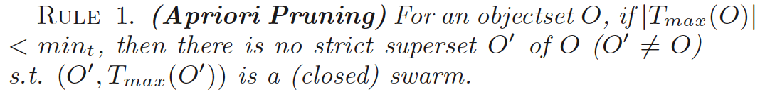
ObjectGrowth: Apriori pruning
min_{o} = 2
min_{t} = 2
|T_{max}(O)| < min_{t}

Slide 17
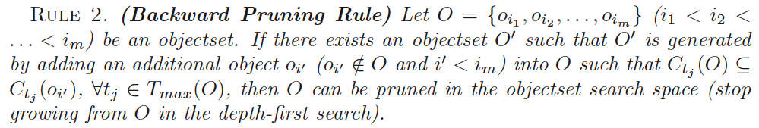
ObjectGrowth: Backward Pruning
T_{max} of {o₁,o₄} is {t₁,t₂,t₄} = T_{max} of {o₁,o₂,o₄} is {t₁,t₂,t₄}.
Node {o1,o4} and its subtree is pruned.

Slide 18
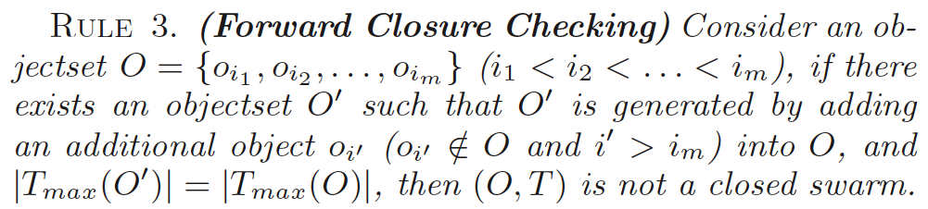
ObjectGrowth: Forward Closure Checking
Nodes passed Apriori and Backward pruning rules are NOT necessarily closed swarms.
{o₁,o₂},{t₁,t₂,t₄} is not a closed swarm because there is a (closed) swarm in its subtree.

Slide 19
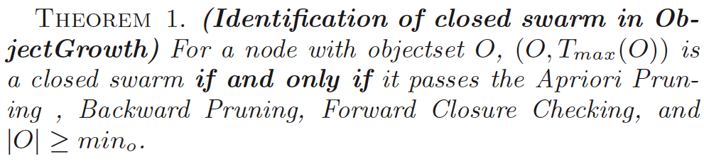
ObjectGrowth: Identification of Closed Swarms
closed swarms must pass all the rules
Apriori, Backward and Forward rules
Closed swarm
nodes passed rules must be a closed swarm?
YES! if |O|≥min_{o}
With the Theorem, we can output the closed swarm on-the-fly in the search process.

Slide 20
ObjectGrowth: Summary
min_{o} = 2
min_{t} = 2
Start with empty objectset
Not a closed swarm by Forward Closure Checking
Pruned by Apriori
Pruned by Apriori
Pruned by Backward pruning rule
Pruned by Apriori
Passed all the rules and |O|≥2
Output this node as a closed swarm
Passed all the rules and |O|≥2
Output this node as a closed swarm
Pruned by Apriori
Two closed swarms detected.

Slide 21
Outline
Motivation
Problem Definition
Algorithm
Experiment
Summary
Discussion

Slide 22
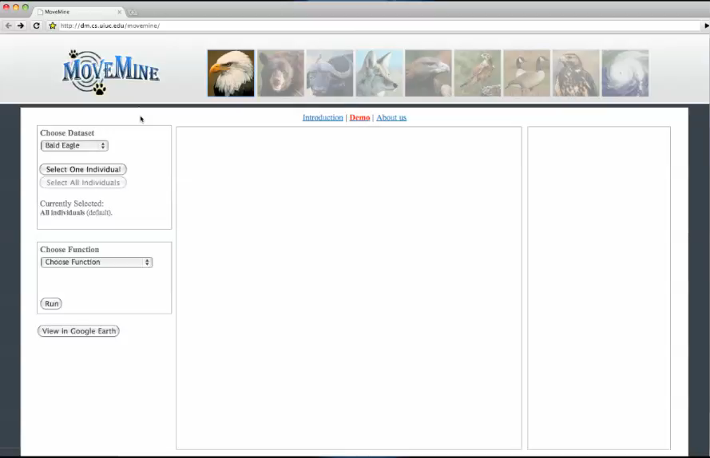
SWARM: A Component in MoveMine
dm.cs.uiuc.edu/movemine
Zhenhui Li et al., “MoveMine: Mining Moving Object Databases" (system demo), SIGMOD’10

Slide 23
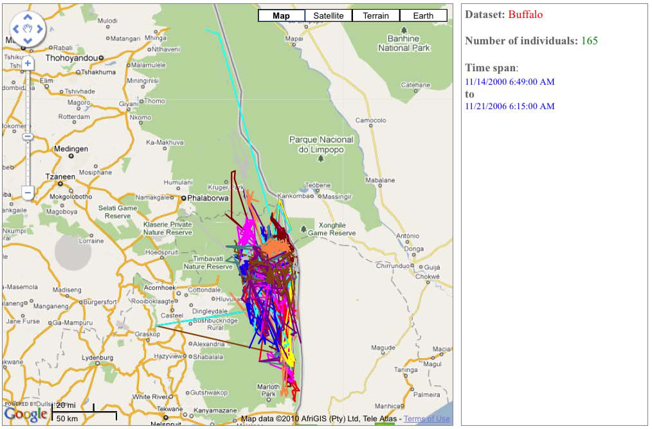
Effectiveness Testing on Real Data
Raw buffalo data
165 buffalo from Year 2000 to Year 2006
DBScan to preprocess the data (minPts=5, eps=0.001)

Slide 24
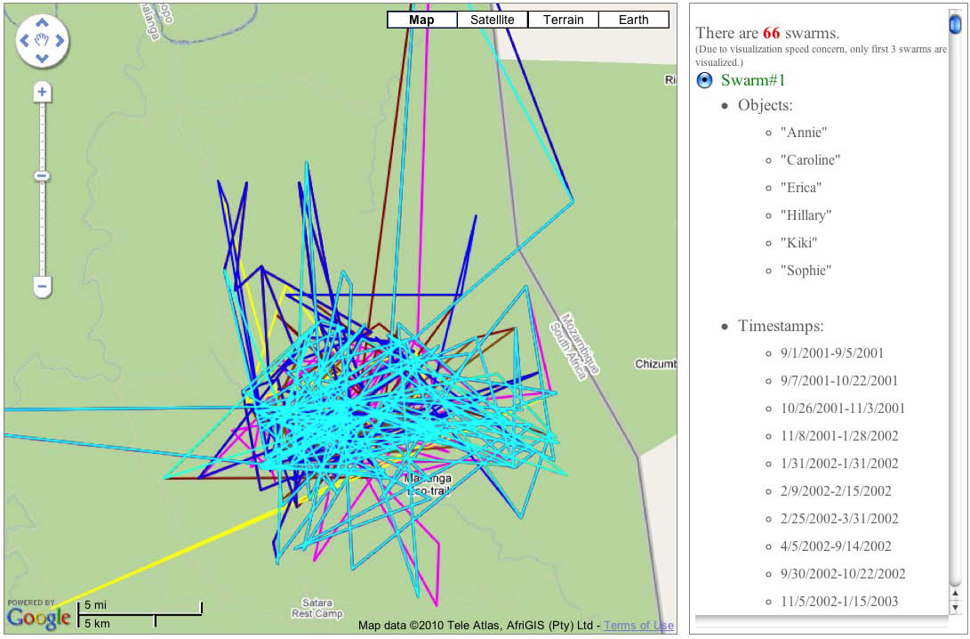
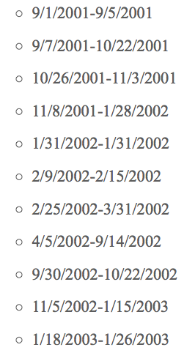
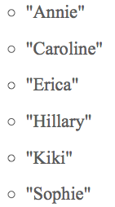
Swarms Mined from Buffalo Data
Parameter: min_{o}=2, min_{t} =0.5(half of the time span)
Result: 66 swarms
Timestamps that they are in the same cluster are NOT consecutive
Notes:
DBScan to preprocess the data (minPts=5, eps=0.001)

Slide 25
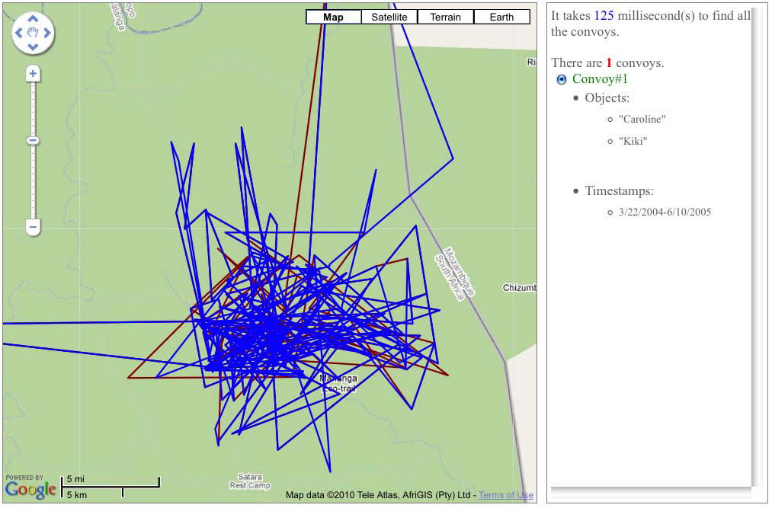


Comparing with Convoy Mining
Parameter: min_{o}=2, min_{t} =0.5 (half of the time span)
Result: 0 convoy!
Parameter: min_{o}=2, min_{t}=0.2 (20% of the time span, lower temporal constraint)
Result: 1 convoy
swarm
This convoy is only a subset of one swarm.
A period of consecutive time.

Slide 26
Efficiency: Test on Synthetic Data
Number of objects: 500, number of timestamps: 10⁵
Parameter: min_{o}=0.01, min_{t} =0.01
VG-Growth is DFS with Apriori pruning rule only
ObjectGrowth+ is for probabilistic data (see paper Appendix)
Vary the database size

Slide 27
Efficiency: Test on Synthetic Data
Number of objects: 500, number of timestamps: 10⁵
Parameter: min_{o}=0.01, min_{t} =0.01
VG-Growth is DFS with Apriori pruning rule only
ObjectGrowth+ is for probabilistic data (see paper Appendix)
Vary the parameter

Slide 28
Outline
Motivation
Problem Definition
Algorithm
Experiment
Summary
Discussion

Slide 29
Summary
Our goal is to detect the moving object clusters.
Swarm, by relaxing the temporal constraint, can discover moving object cluster in real scenarios.
ObjectGrowth algorithm is proposed to mine all the closed swarms.
  Apriori pruning rule
  Backward pruning rule
  Forward Closure checking

Slide 30
Outline
Motivation
Problem Definition
Algorithm
Experiment
Summary
Discussion

Slide 31
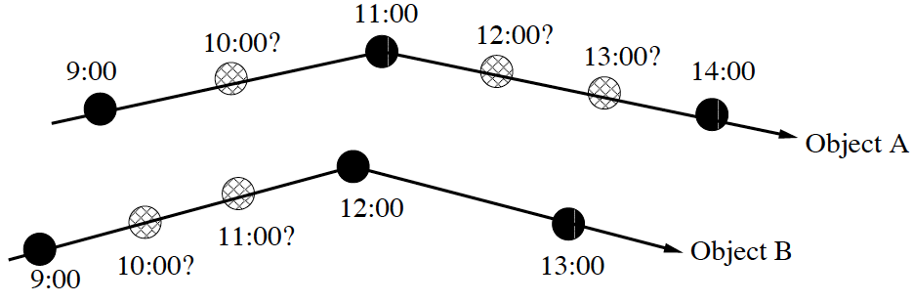
Discussion
Missing data interpolation
Different time constraint
  A and B are together for 12 days in a year
  A and B are together for one day in each month
Swarm ranking
  A and B form a swarm
  C and D form a swarm
  which has closer relationship?

Slide 32
THANKS!
http://www.cs.uiuc.edu/homes/zli28
zli28@uiuc.edu

